Slide 1
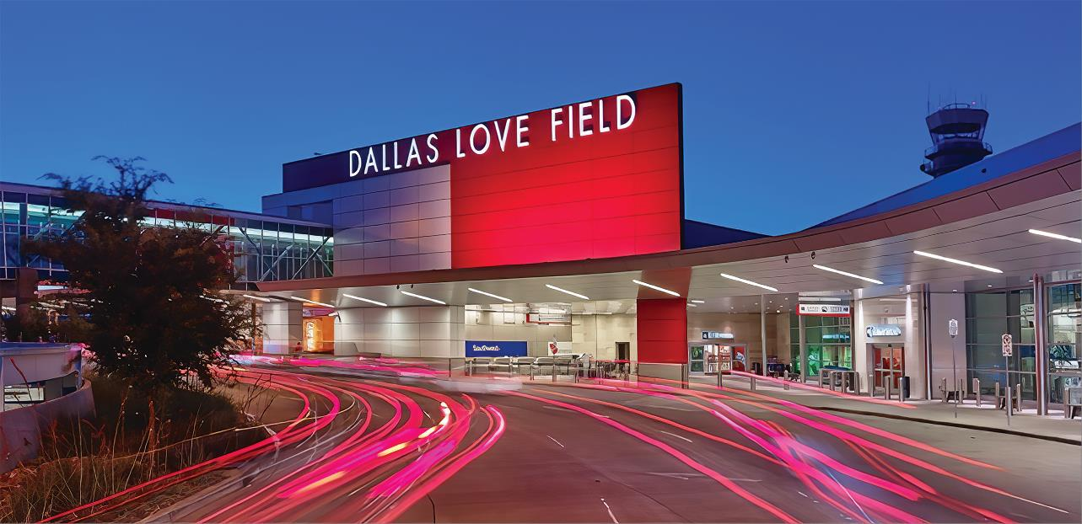
Love Field Environmental Advisory Committee Meeting
April 14th, 2022
Dallas Love Field
7555 Lemmon Ave

Slide 2
Agenda
Introductions
Runway 13R/31L Reconstruction
Voluntary Noise Program
Noise Reports
Public Comment Period
Adjourn

Slide 3
Voluntary Noise Program

Slide 4
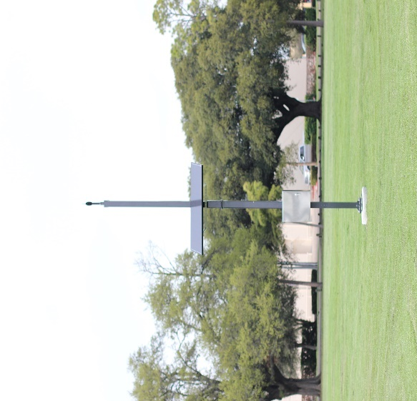
Dallas Love Field’s Voluntary Noise Program
To better respond to the concern of our neighbors, the City of Dallas’ Department of Aviation has developed a Voluntary Noise Program for the Airport.
DOA serves as a liaison between the community and FAA while also disseminating noise information to stakeholders through outreach.
The Federal Aviation Administration controls the National Airspace System in the United States.
FAA’s Air Traffic Control directs commercial air traffic to and from DAL Airport.
DAL’s Noise and Operations Monitoring System (NOMS) utilizes Casper Airport Solutions as its advanced system that enables the City of Dallas to monitor and better understand aircraft noise in the vicinity of the Airport. The system is comprised of 4 fixed noise monitors in the community.

Slide 5
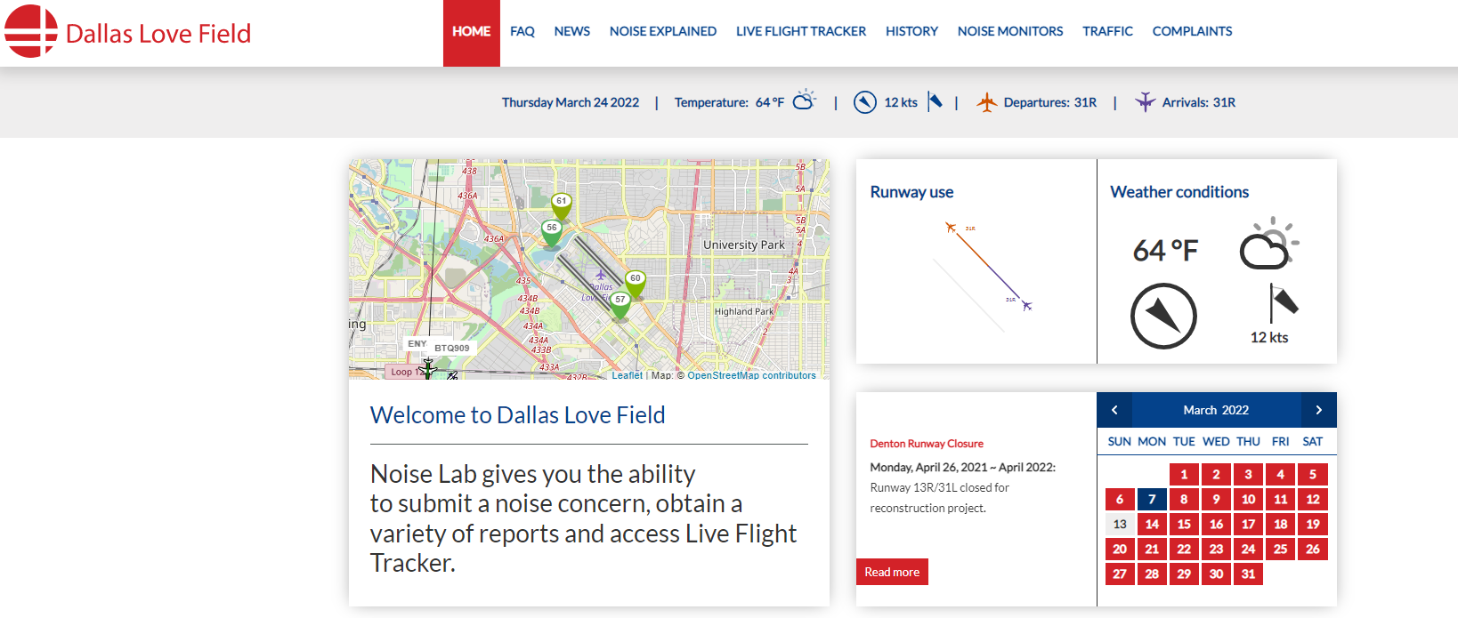
NoiseLab
Casper NoiseLab is an interactive public website that provides current information on aircraft noise, runway closures, outreach efforts and other useful information. It also displays statistical information on flights/noise on a map and using charts.
https://dal.noiselab.casper.aero/

Slide 6
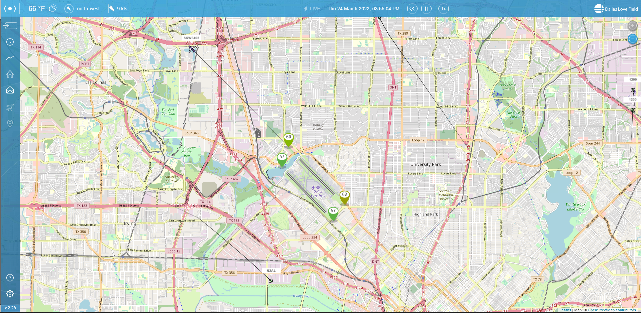
Flight Tracker
As part of the Voluntary Noise Program, Dallas Love Field Airport invested in an online tracking system for the movement of flights and air traffic patterns within the DFW Metroplex. Flight Tracker allows concerned individuals to research data about flights to and from Dallas Love Field Airport or Dallas Executive Airport as well as any transitional air traffic through the region. The system also simplifies the process of filing a noise complaint by offering an easy, online option for residents to register noise concerns.
https://flighttracker.casper.aero/dal/

Slide 7
Operation Statistics ( Jan – Mar 2022 )
Definitions
Air Carrier – A commercial carrier utilizing aircraft as its means of transport; an airline, as for passengers or freight.
General Aviation – All civil aviation operations other than scheduled air services and non‐scheduled air transport operations
for compensation or hire.
Other – Medical and Military flights
Source: Casper Airport Solutions Inc.

Slide 8
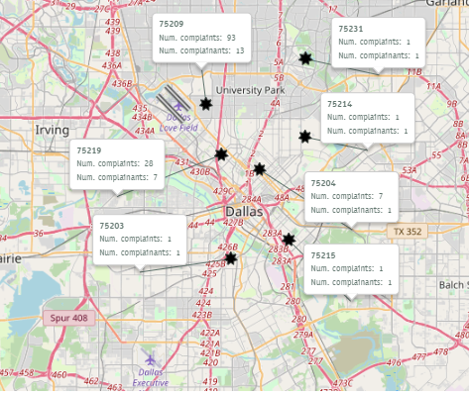
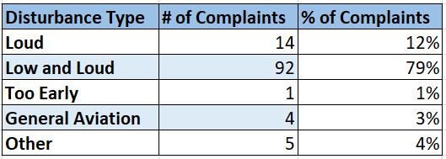
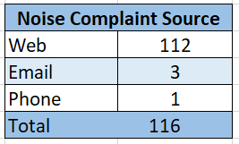
Noise Complaints ( Jan – Mar 2022 )
*Disclaimer: The map only displays zip codes
in the immediate Dallas Love Field area
Source: Casper Airport Solutions Inc.

Slide 9
Radar Track Density Map
( Jan – Mar 2022)
The following map takes all the flight track data for the given time period and creates a line density plot. Dark red in the middle of the picture shows the highest density of flight tracks over the runways. The colors gradually move out to blue as the least dense.
Source: Casper Airport Solutions Inc.

Slide 10
Noise Program Briefing to Environmental Commission April 13, 2022

Slide 11
Department of Aviation is briefing Environmental Commission:
Address findings from the City Auditor’s report on the Department’s Voluntary Noise Program
Present Department of Aviation’s recommendations to update the Voluntary Noise Program
Department of Aviation will present updates at the Environment & Sustainability Council Committee on May 2nd

Slide 12
Runway 13R-31L/ Taxiway C Phase 1 Reconstruction

Slide 13
Phase | Duration | 3/21 | 4/21 | 5/21 | 6/21 | 7/21 | 8/21 | 9/21 | 10/21 | 11/21 | 12/21 | 1/22 | 2/22 | 3/22 | 4/22 | 5/22 | 6/22 | 7/22 | 8/22 | 9/22 | 10/22
1
*RWY Shutdown
*2
*3
4
5
Overall Project 62%
Phase-1 is at 99%
Phase-2 & 3 is at 65%
Phase 4 is at 75%

Slide 14
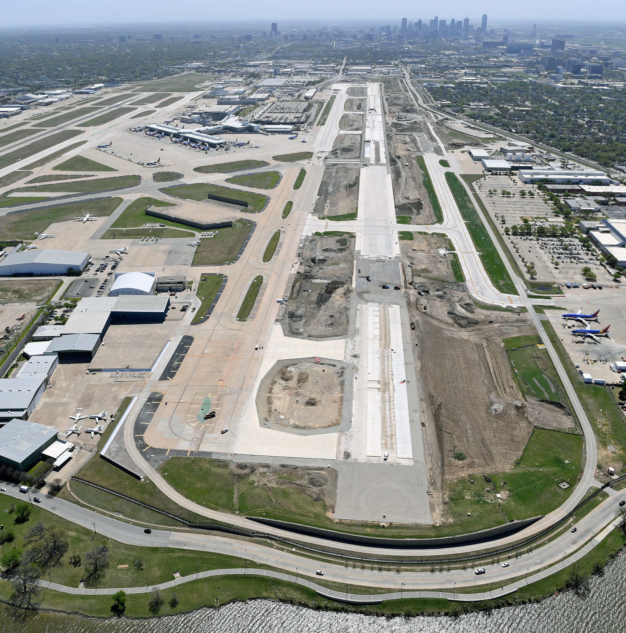
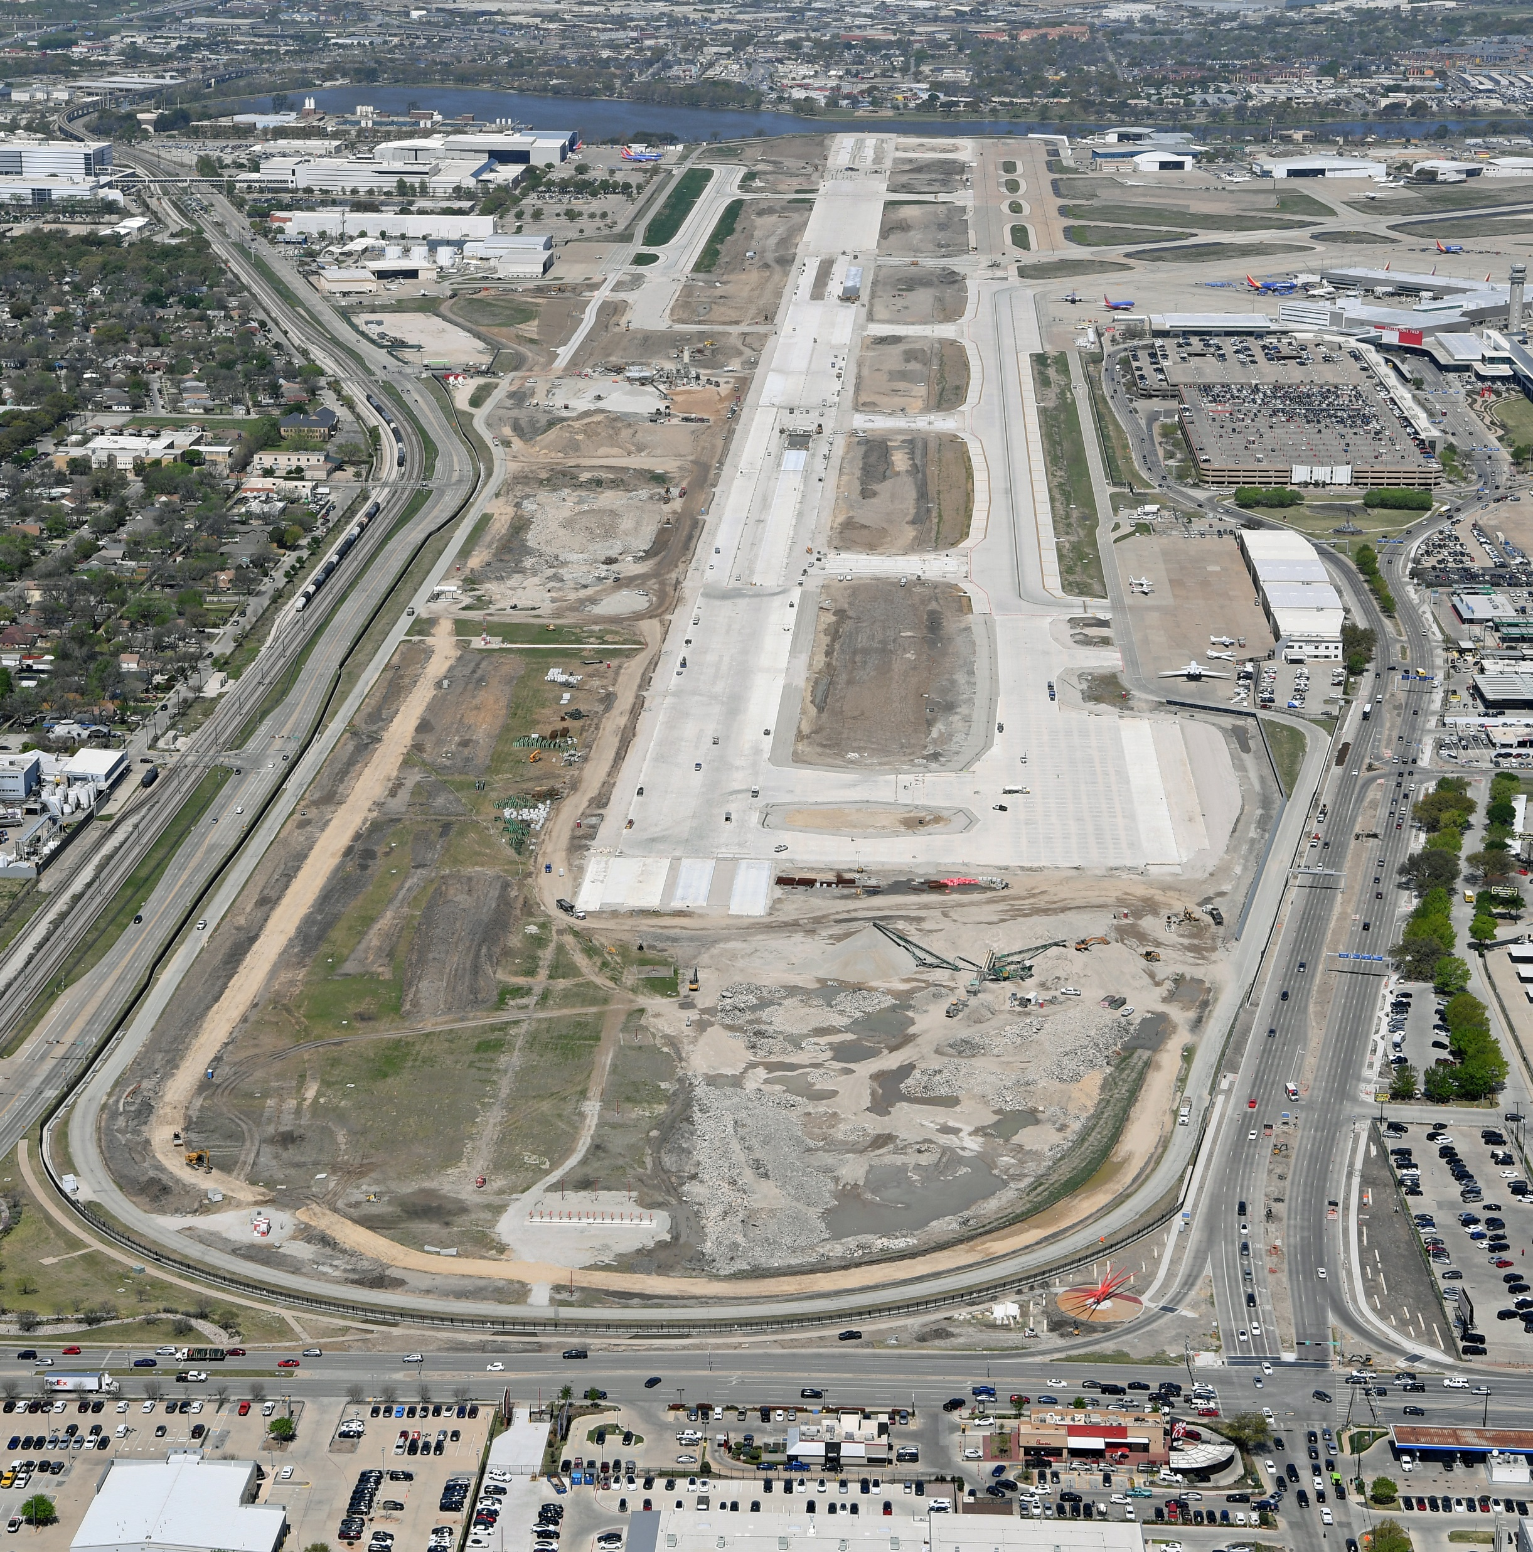
Runway 13R-31L Reconstruction
Figure 1 - RWY 13R looking SE
Figure 2 - RWY 13R/31L and TWY C under construction
Notes:
Some photos from the air of the construction

Slide 15
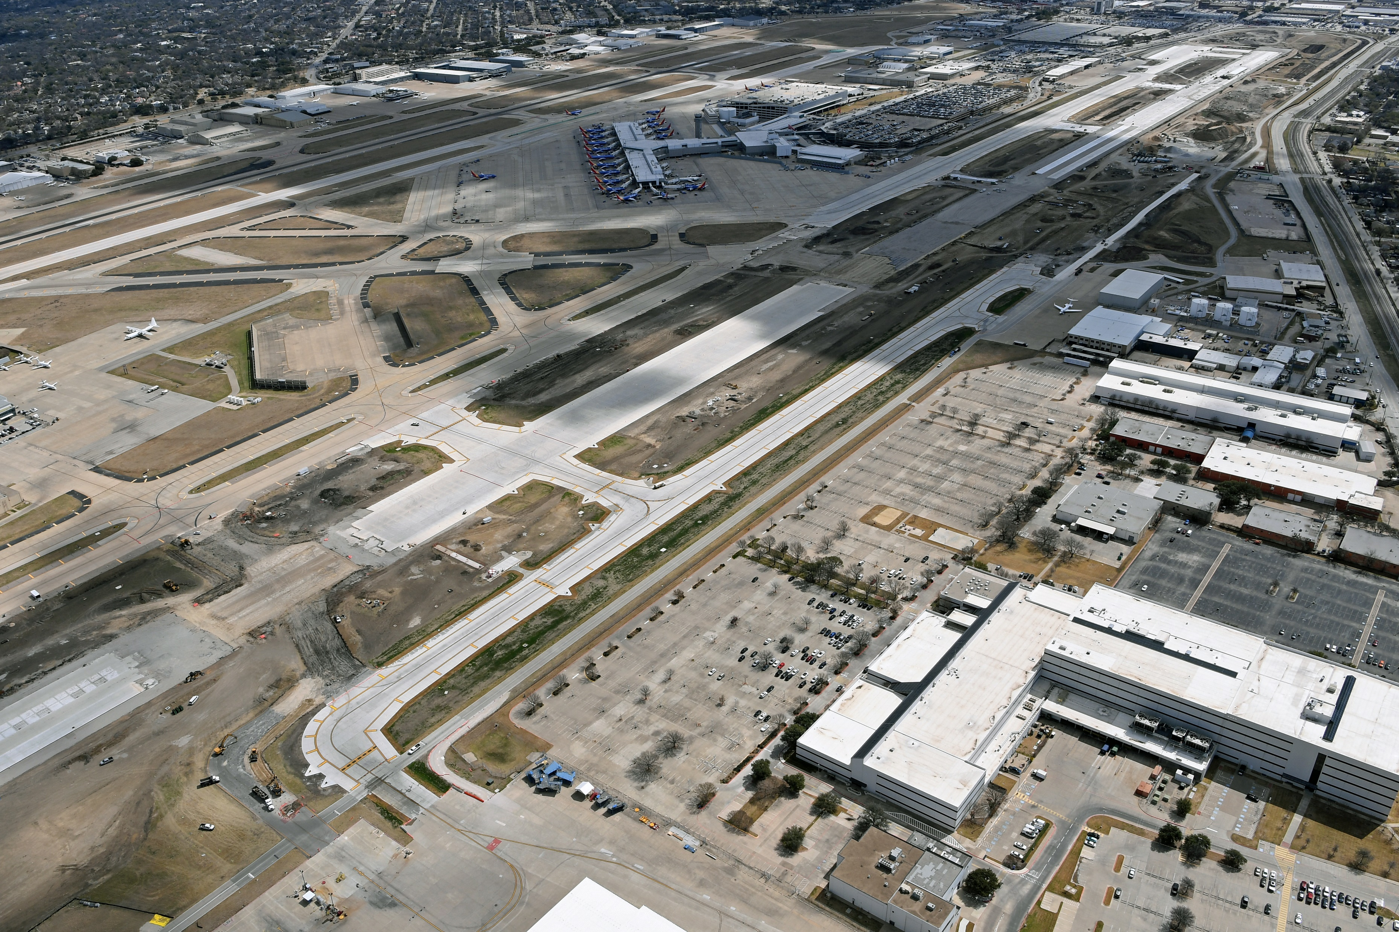
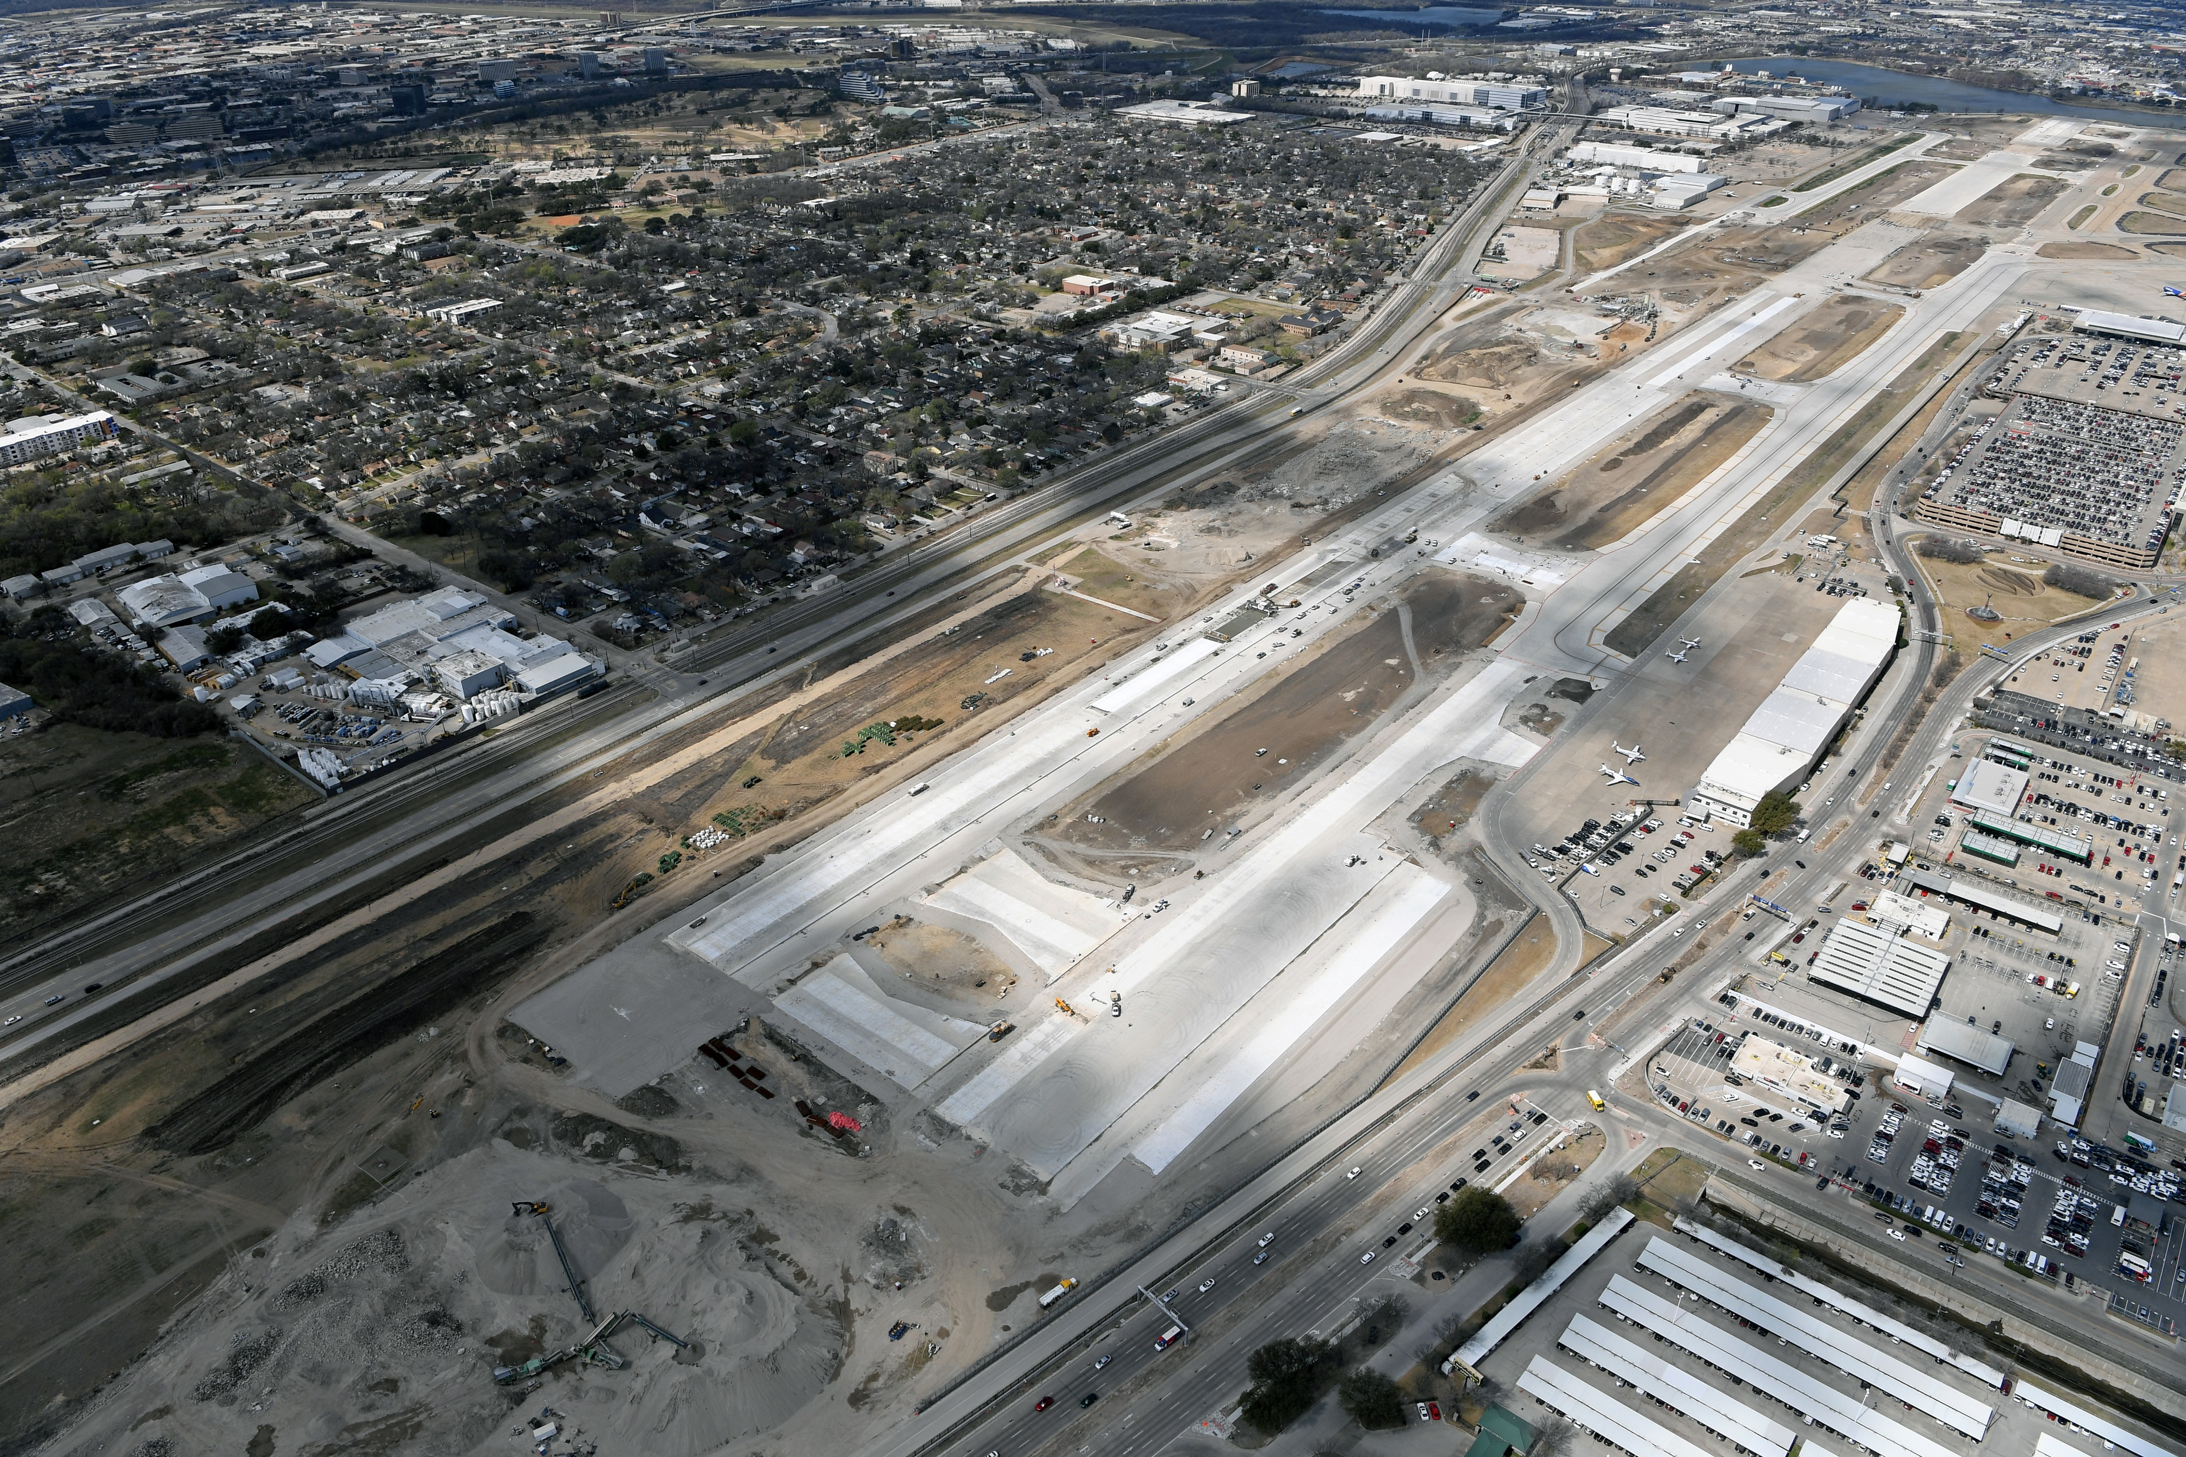
Runway 13R-31L Reconstruction
Figure 3 - New TWY T under Operation and north half of RWY 13R/31L under construction
Figure 4 - TWY C under operation south half of RWY 13R/31L under construction

Slide 16
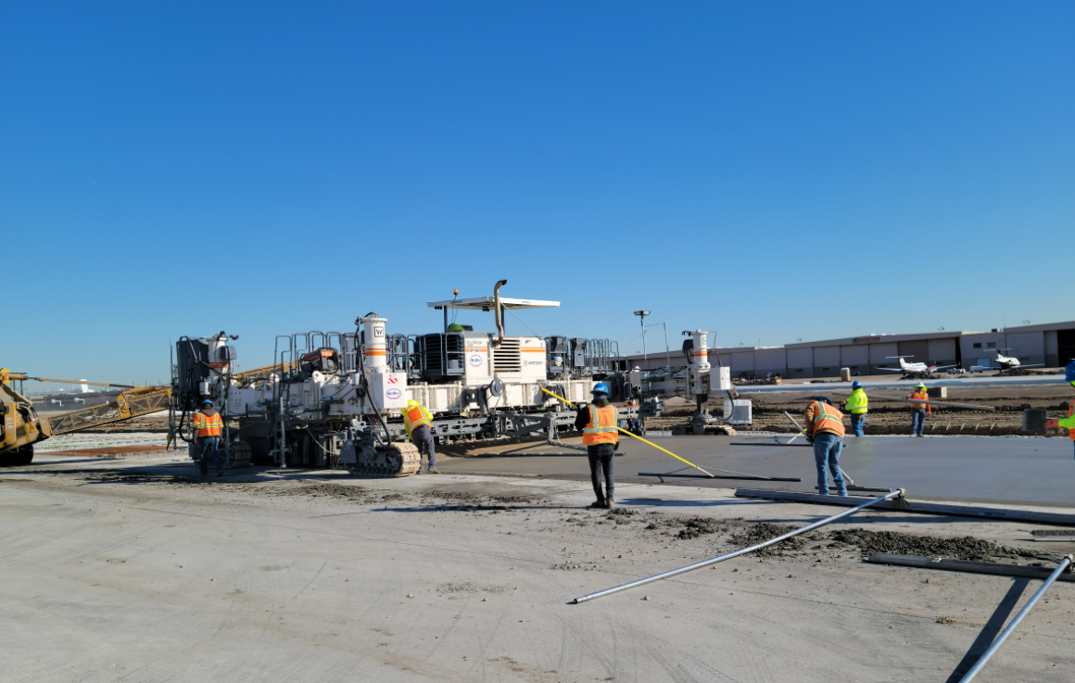
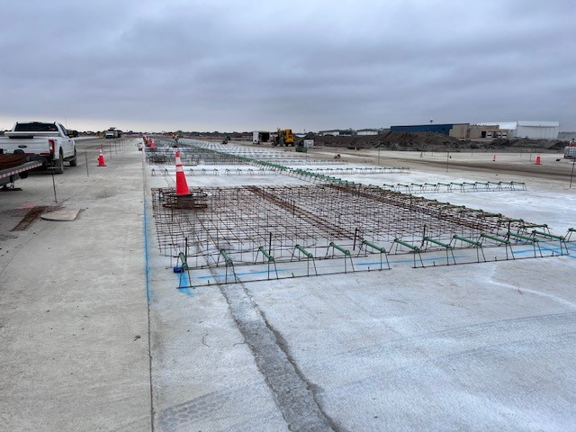
Runway 13R-31L Reconstruction
Figure 5 – RWY 13R/31L with placing final concrete pavement layer
Figure 6 – RWY 13R/31L, final pavement layer preparation

Slide 17
OPEN DISCUSSION and QUESTIONS

Slide 18
Adjourn
Next LFEAC Meeting
on
July 14, 2022, at 6 p.m.
For noise concerns visit
https://dal.noiselab.casper.aero/
For noise inquires email
AVINoise@dallascityhall.com

